Slide 1

The Green Team
By Dr. Jean

Slide 2
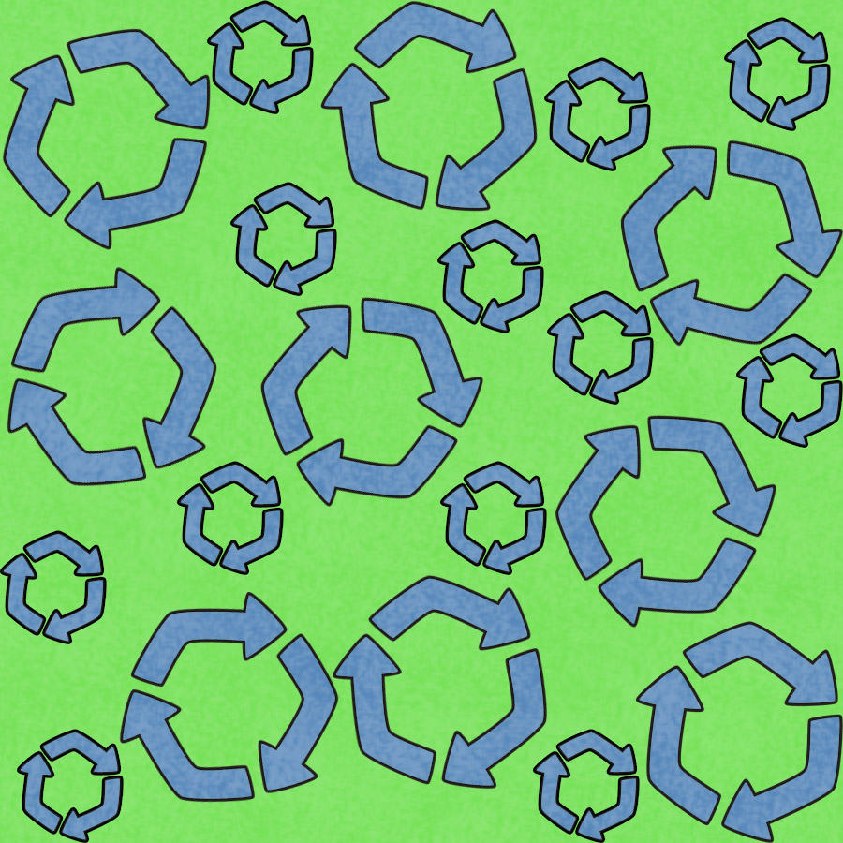
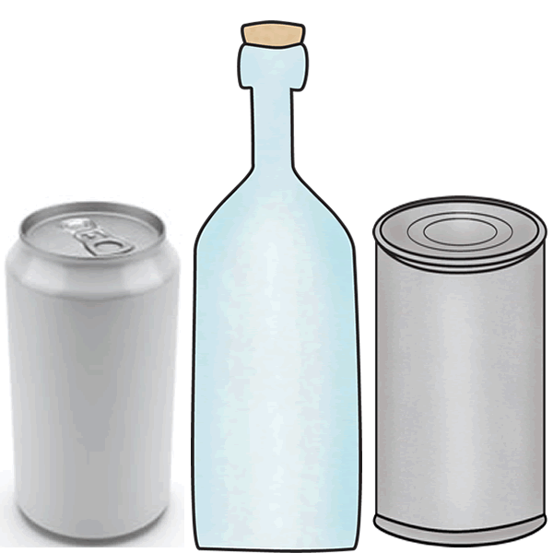
We are on the Green Team.
(March in place as you swing your arms.)
Hoorah! Hoorah! (Fist in air as if cheering.)
We can recycle every day.
(March in place as you roll your arms around.)
Hoorah! Hoorah! (Fist in air as if cheering.)
Aluminum, glass, tin, (March in place.)

Slide 3
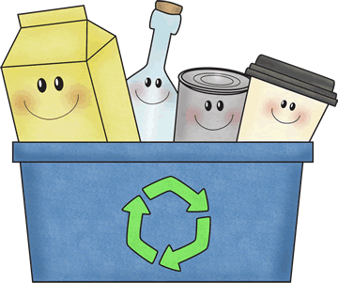
Put paper and cans in recycle bins. (March in place.)
Join the Green Team, (March in place.)
Defend the earth and keep it clean. (Put both fists in the air like a hero.)

Slide 4


We are on the Green Team. Hoorah! Hoorah!
We can reduce what we use. Hoorah! Hoorah!
Turn off water and the lights.

Slide 5
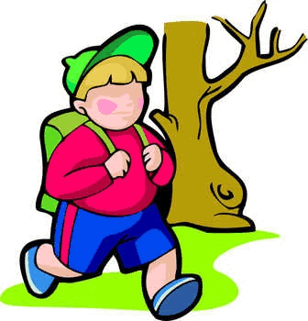


Walk, take a bus, or ride your bike.
Join the Green Team.
Defend the earth and keep it clean.

Slide 6
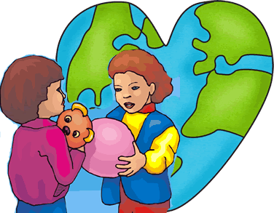
We are on the Green Team. Hoorah! Hoorah!
We can reuse many things. Hoorah! Hoorah!
Share old toys and old clothes, too.
Give away what you don't use.
Join the Green Team,
Defend the earth
and keep it clean.

Slide 7
Credits
Song by
Dr. Jean Feldman
Graphics by
Scrappin Doodles

