Slide 1
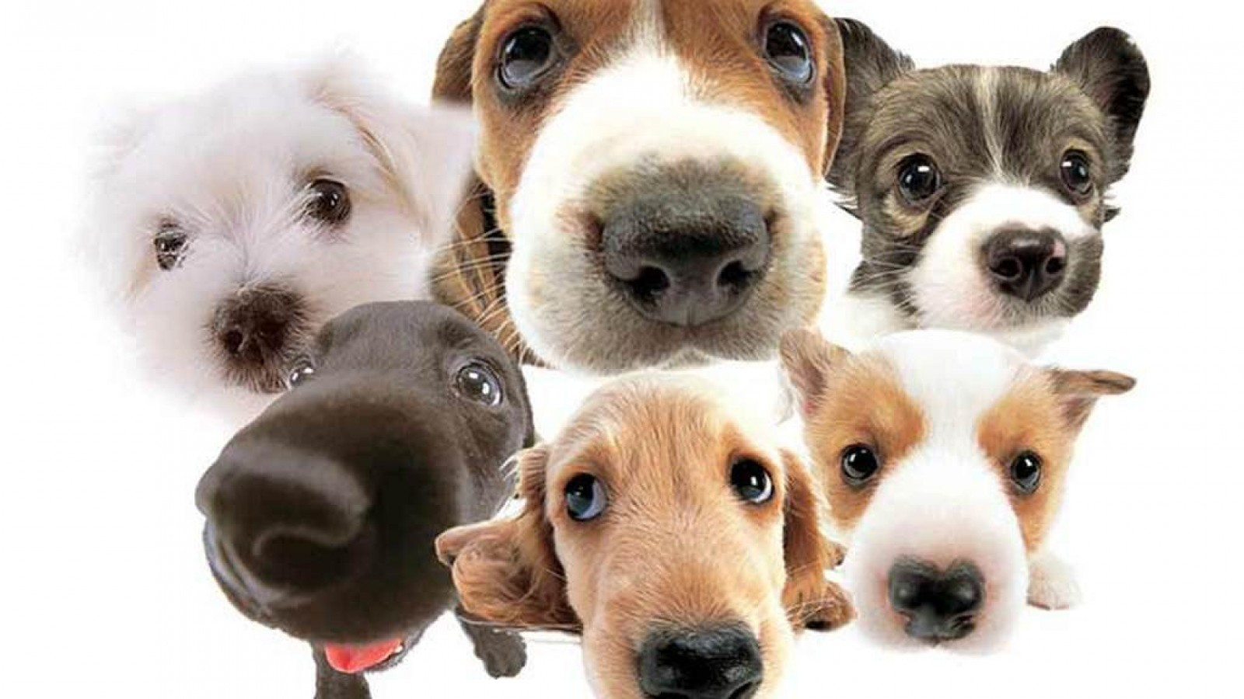

The kids and the six dogs arrive Saturday. Barky! Barky!

